Slide 1

CAREER WEEK
Day 1

Slide 2


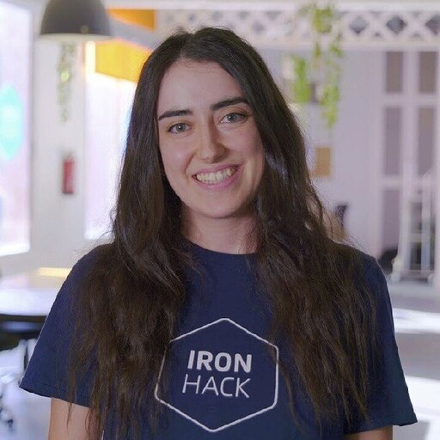
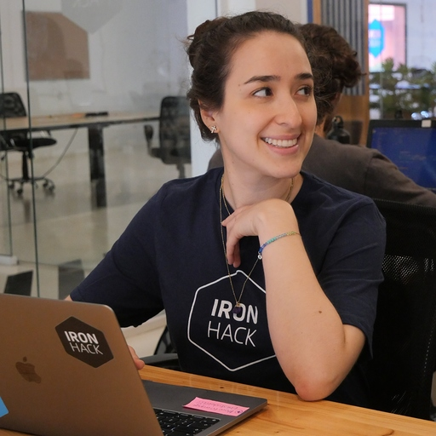
Your Career Services team:
Clara
Alicia
Leidy Laura
Student Success Manager Web Dev
Student Success Manager Data
Student Success Manager Manager UX/UI

Slide 3

You did it!

Slide 4
But…

Slide 5
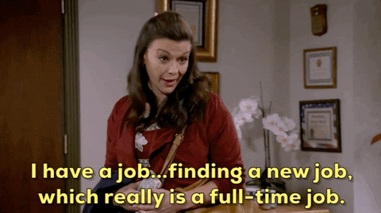

Slide 6

WELCOME TO CAREER WEEK

Slide 7
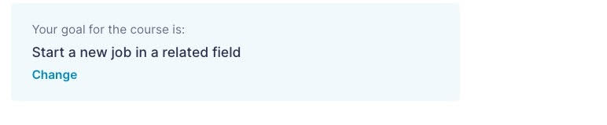
REMEMBER TO UPDATE YOUR GOAL!
📍 Student Portal Homepage
Notes:
To make sure that you have access to it, all of you should have this status on the Student Portal - this way you’ll be considered a searching student - someone who’s searching for a job
From the searching students, is there anyone who doesn’t want to start the job hunt straight away?
If yes - you should update your goal for the course as well, because you’ll be asked when you want to start and you should set another date.

Slide 8


INDEX
.Our goal
. Notion page walk around . Our schedule for the week & today . Community guidelines
. Takeaways for success

Slide 9


Career Week
Goal
How?
To equip you with knowledge and tools for the job search 🚀
Notion Page
Target content and resources
Live and self-guided sessions
Learn and practice
Industry professionals
Prepare your questions for them
Interview mock-up & Tech challenge
Practice your interviewing skills
Huntr
Job Tracker

Slide 10


Soft skills + employability training to be job-hunt ready
Section 1: Discovery
Section 2: Profiles
Section 3: Job Hunt
Consists of 2 tasks on your career goal, and 2 activities on soft skills and personal brand.
Deliverables to complete: Section 1 exercises (Deadline: Now)
Creation of your CV and LinkedIn profiles and uploading them to your Student Portal Section 2.
Deliverables to complete: Upload CV & LinkedIn on Section 2 (Deadline: Day 1 of Career Week)
Receiving Career Week training after your bootcamp and starting your job-hunt.
Deliverables to complete:
CV, LinkedIn, action plan (Deadline: June 11th)
Careerhack

Slide 11
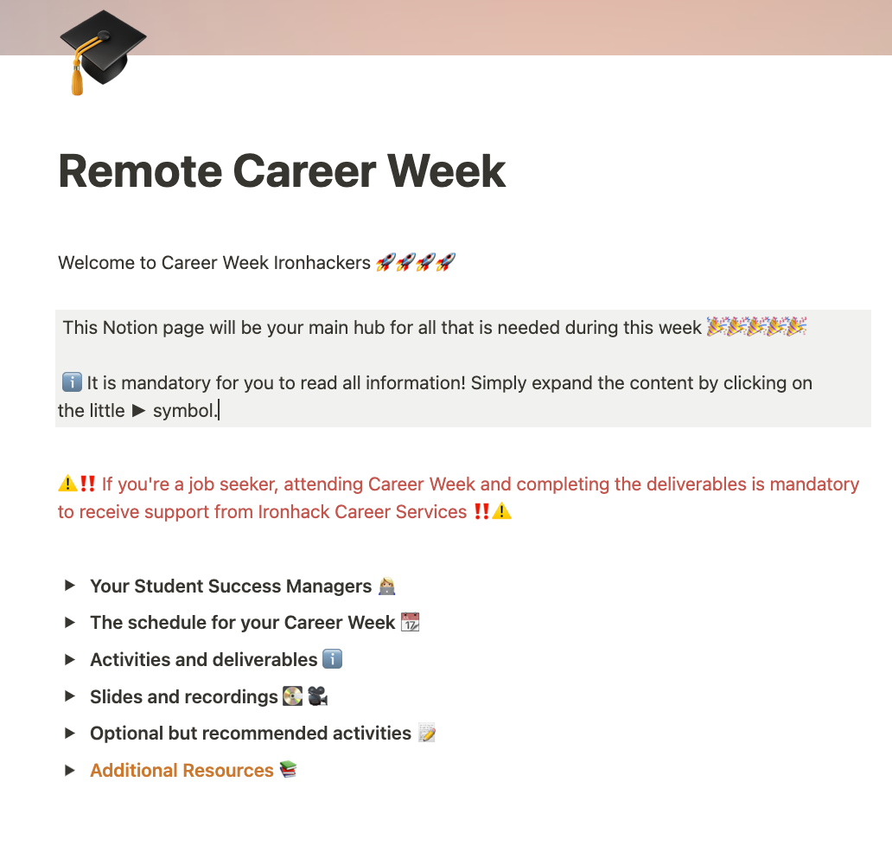
YOUR NOTION PAGE
Your go-to for general information and all the resources during the Career Week.

Slide 12
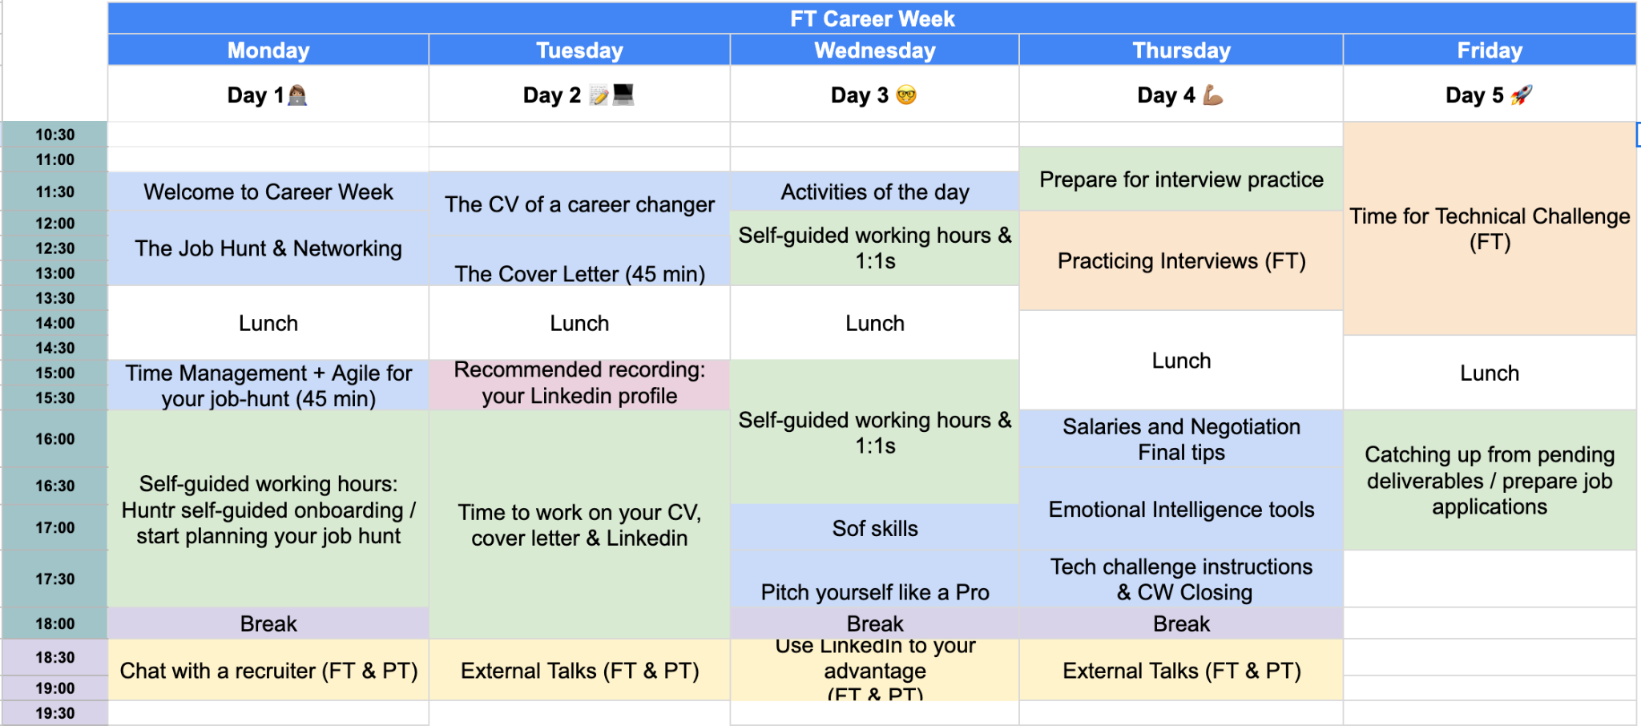
Our schedule

Slide 13
Self-guided working hours
MONDAY
Self-guided Huntr onboarding.
Action plan (deliverable).
TUESDAY
Working on CV, LinkedIn.
15-20 minutes 1-1’s (limited spots, by demand).
WEDNESDAY
Work on portfolio.
Applying for jobs/add jobs to your wishlist.
15-20 minutes 1-1’s (limited spots, by demand).

Slide 14

Career Week Deliverables
1️⃣ CV/LinkedIn
2️⃣ Action plan
3️⃣ Tech challenge (June 9th)
4️⃣ 5 job applications on Huntr
Last day of submission: June 11th

Slide 15

Notes:
By this Friday:
CV final version + Professional Profile with 90% of completion
Stage 1 survey - red banner in your Student Portal
Attend all CW sessions - content + practice
Submit all the CW deliverables - 7 tasks

Slide 16


Goals & Expectations
As part of our careers support program, we expect you to use Huntr to track certain goals we think will ensure a successful job search. Your assigned coach will do weekly reviews within Huntr to ensure that you are achieving your goals.
Description
Interval
Activity Count
Activity Type
Deadline
Apply to 5 jobs per week
5
Apply
Sunday of each week

Slide 17

COMMUNITY GUIDELINES
#1 Listening is the first step to good communication: we listen to each other
#2 We talk to each other with respect and embrace different opinions
#3 We accept and provide constructive feedback
#4 We understand that there might be different ways of looking at & doing things
#5 We use the chat to engage in conversations related to the topic at hand

Slide 18
Key-takeaways for success
#1 Be creative! We provide tools, but remember there’s no magic formula.
#2 Everything you learn this week - put it in practice already!
#3 Ask for help, support and advice to us & the community- you are not alone in this
#4 Sometimes there is no wrong & right approach - there is YOUR approach
#5 Keep a positive and curious attitude and be engaged :)

Slide 19
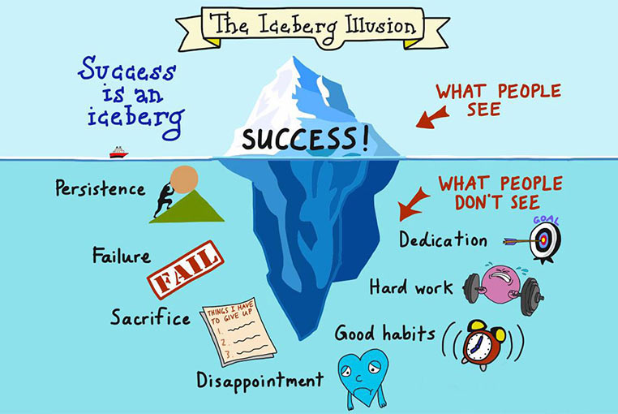
Success
=
Finding a job

Slide 20


Thank you!

